Slide 1
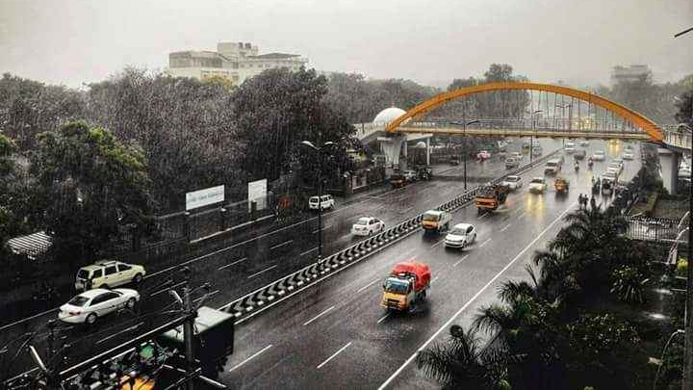
THE BATTLE OF NEIGHBORHOODS
IBM DATA SCIENCE CAPSTONE
COURSERA

Slide 2
ABOUT THE CITY:
Manchester Of South India
Lots of Colleges and Hospitals
Best Weather

Slide 3

TARGET AUDIENCE:
Those who are looking for the perfect location to open their restaurants, cafes, etc.
Localities with a greater number of restaurants present currently, have the greatest demand thereby earning high profits.
Question to be answered…
Which is the best location to open a restaurant (food place) at Coimbatore?

Slide 4
DATASET:
Coimbatore Data
Link: https://news.abplive.com/pincode/tamil-nadu/coimbatore.html
Geospace Data
To fetch the coordinates of the Post Offices
Foursquare Data
Localities with a large number of restaurants indicate the high demand.
Consists of a table that includes the name of the Post Offices (Similar to neighborhoods), Taluks (Similar to Boroughs), District, State, and Postal Code.
This API is employed to fetch the nearby venues

Slide 5
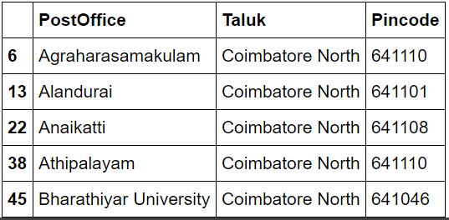
WEB SCRAPPING AND PRE-PROCESSING:
The text scrapped from the link is then parsed using Beautiful Soup thereby creating a beautiful soup object.
The table from the soup object is converted into a pandas data frame.
There are 587 unique post offices and 20 unique taluks.
The objective of the project is to find a suitable location to start any food places. Therefore, the main part of the city is concentrated which includes Coimbatore, Coimbatore North and Coimbatore South Taluks.
Processed Data Frame
The resulting data frame consists of 183 instances.

Slide 6
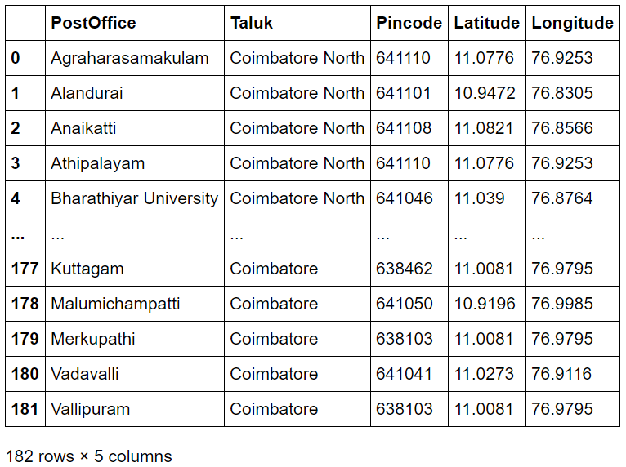
FETCHING COORDINATES:
To plot the localities and to fetch the nearby venues, the coordinates of the localities are essential.
The indices of localities whose coordinates are not fetched are stored in a separate list.
All the coordinates are perfectly obtained without any glitches except for index 113.
This index is dropped from the data frame and the resulting data frame with shape 182 x 5 is obtained.
Data frame incorporating Latitudes and Longitudes

Slide 7
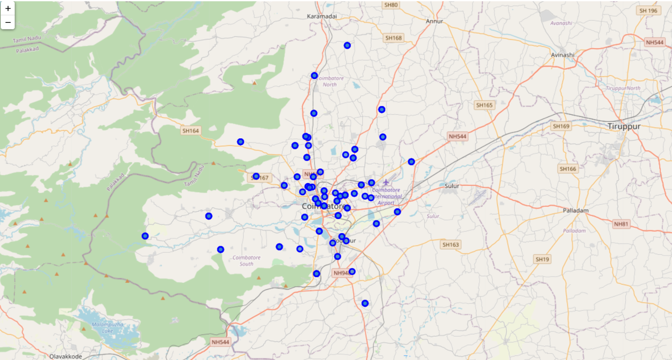
PLOTTING LOCALITIES:
An interactive map is generated using Folium with all the Post Offices mapped.

Slide 8
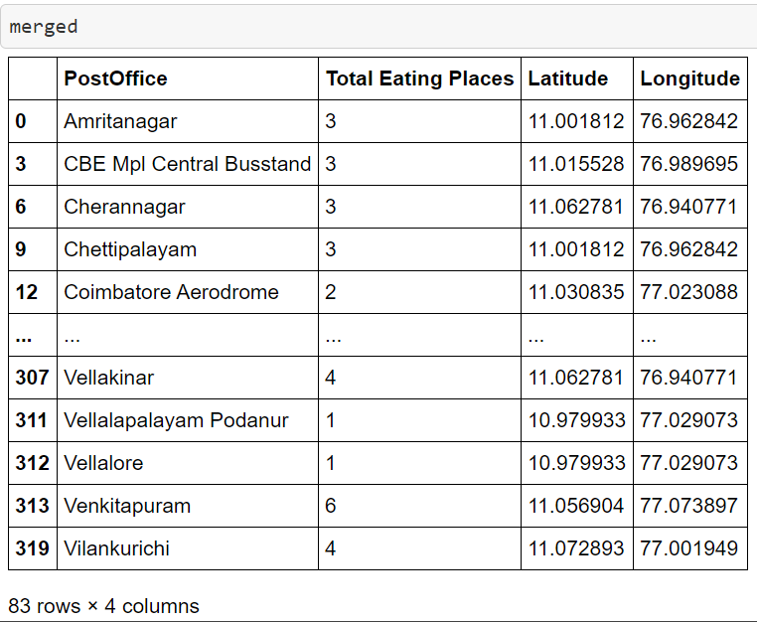
FETCHING VENUES USING FOURSQUARE:
Using the foursquare API, the venues that are around 500 mts from the localities are fetched.
The resulting data frame consisted of 508 venues with 61 unique categories.
Out of all the venue categories, all the categories related to food are alone considered.
The data frame is then encoded and the total number of eating places are calculated for all the localities by summing up the columns.
The latitudes and longitudes are then merged with the resultant data frame.
Final Data frame

Slide 9
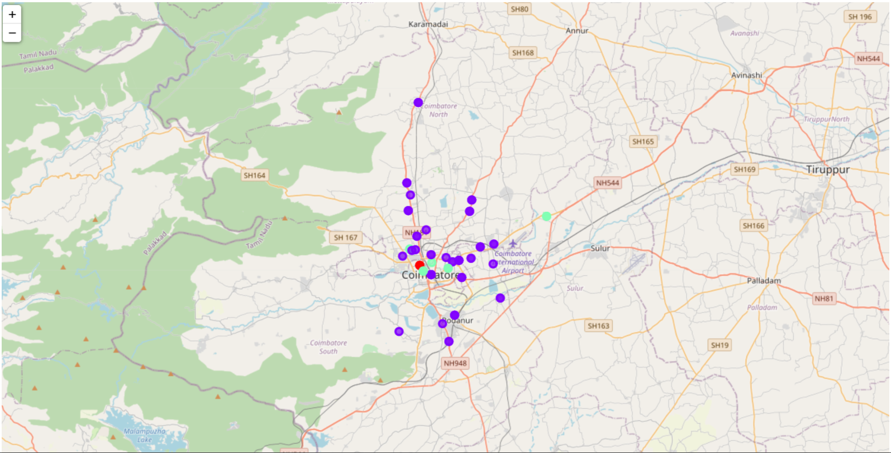
CLUSTERING:
K-Means clustering is performed on the resulting data frame with the aim of clustering the whole dataset into 3 clusters thereby we can visualize the areas with high/moderate/low demands.
After performing clustering operation, the post offices are visualized using folium, with different colours for each cluster.
Map after clustering

Slide 10
CONCLUSION:
When the localities of each clusters are analyzed, post offices with cluster label 0 have the highest demand (red), those with cluster label 1 have the least demand (violet), and those with cluster label 2 have a moderate demand.
Thus, the areas with red markers have the highest demand for food places and hence, they are the regions to be considered while starting a restaurant.
Thus, the main part of Coimbatore is analysed using various parameters and the resulting localities are grouped into 3 clusters according to the total number of venues nearby.

Slide 11
THANK YOU!

